Slide 1
Analysis of Police Shootings in the US
A Case Study of 2015-2023 Data
By: Etiene Effiong, Ibrahim Ahmed, Paul Asamoah, and Kristen Rupinen

Slide 2
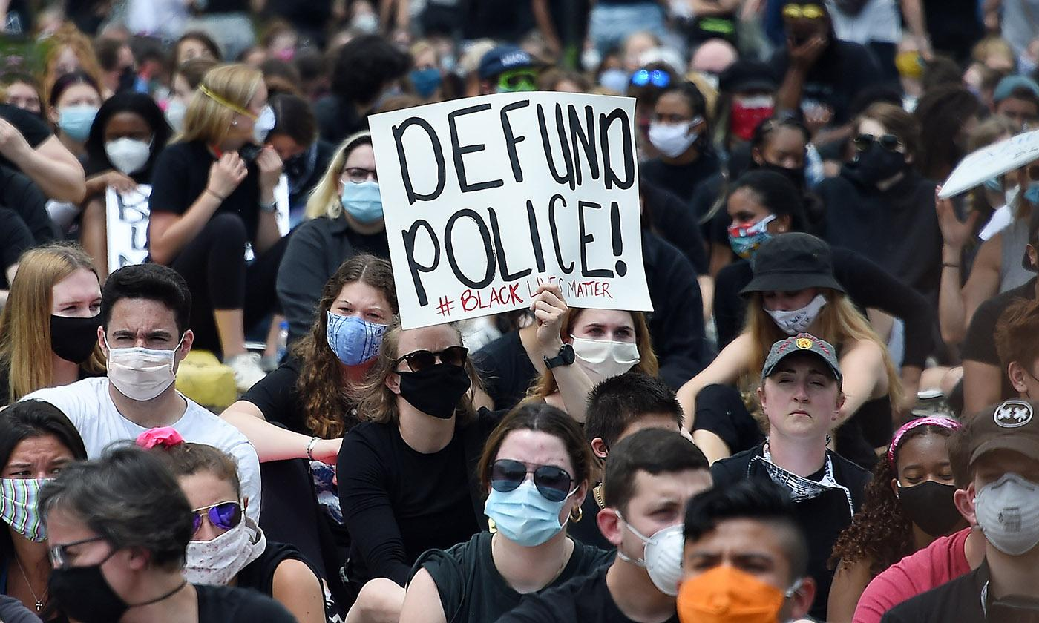
Background
Gun violence has become a more pressing concern over the last few years
Police-involved shootings are a particularly contentious aspect of the broader issue

Slide 3
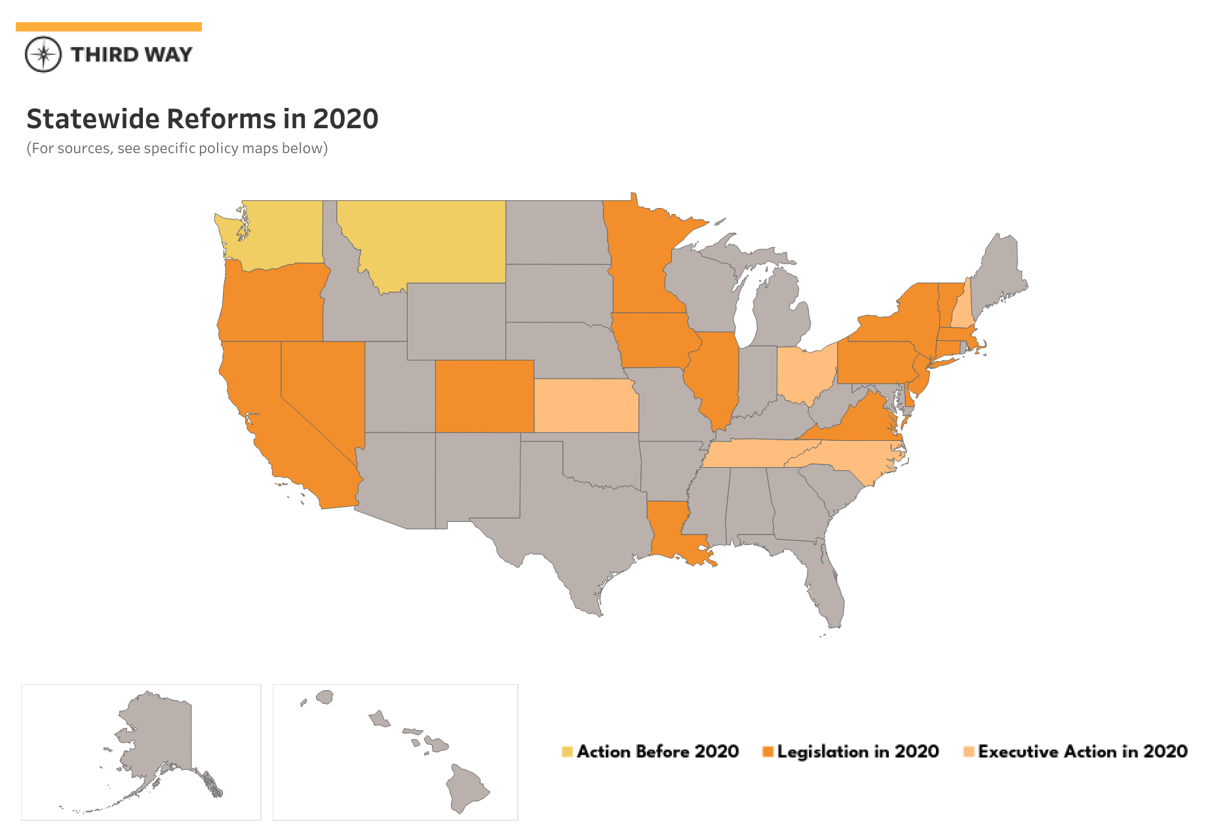
Addressing the multifaceted issues of shootings in America through data analysis has implementations that would affect every corner of America.
Analyzing age, gender and the use of body cameras in a dataset of police shootings is a good step to understand the trends and patterns of law enforcement interaction with civilians.
Background

Slide 4
Methodology
Data Collection
Data Collection Stage
The dataset was collected from Washington Post which comprises of 2015 to 2023.
The data includes demographics, location, and incident details.
Data Preprocessing Stage
Data Cleaning
Data Preprocessing

Slide 5
Methodology
Data Analysis Stage
Descriptive Analysis
Comparative Analysis
Correlation Analysis
Trend Analysis
Data Visualization Stage
Exploratory Data Analysis
Data Analysis
Data Visualization

Slide 6
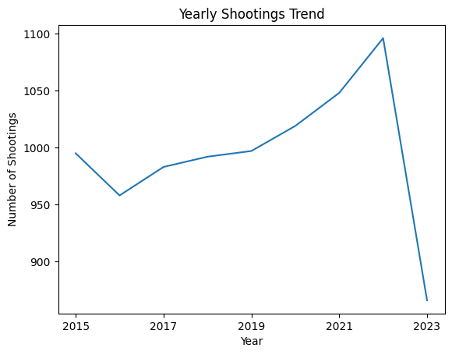
Results
1,096 victims in 2022
866 victims in 2023
- Over 8,594 people have been shot and killed by law enforcement between 2015 and 2023
- 2022 has the highest record of cases

Slide 7
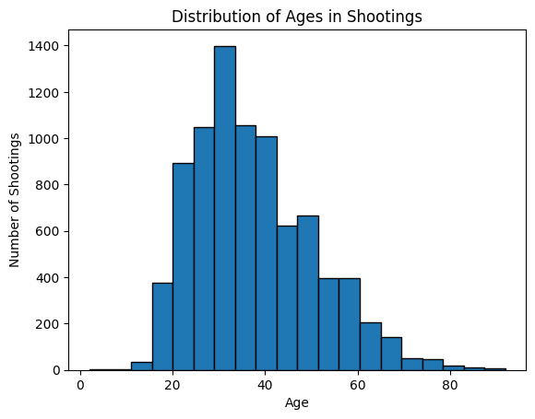
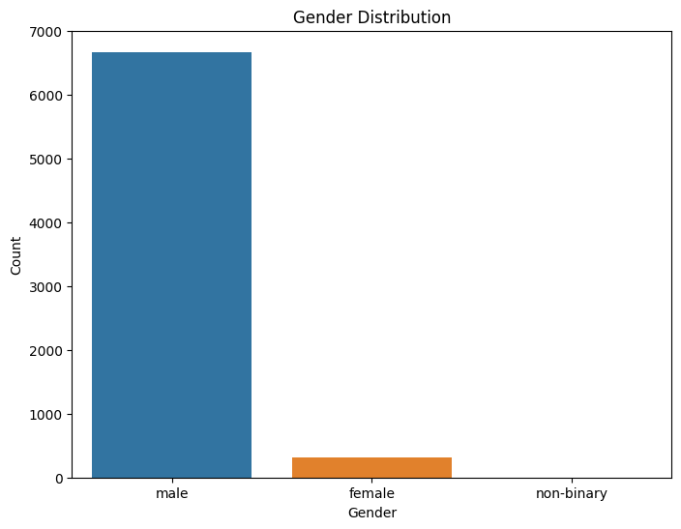
cont’d

Slide 8
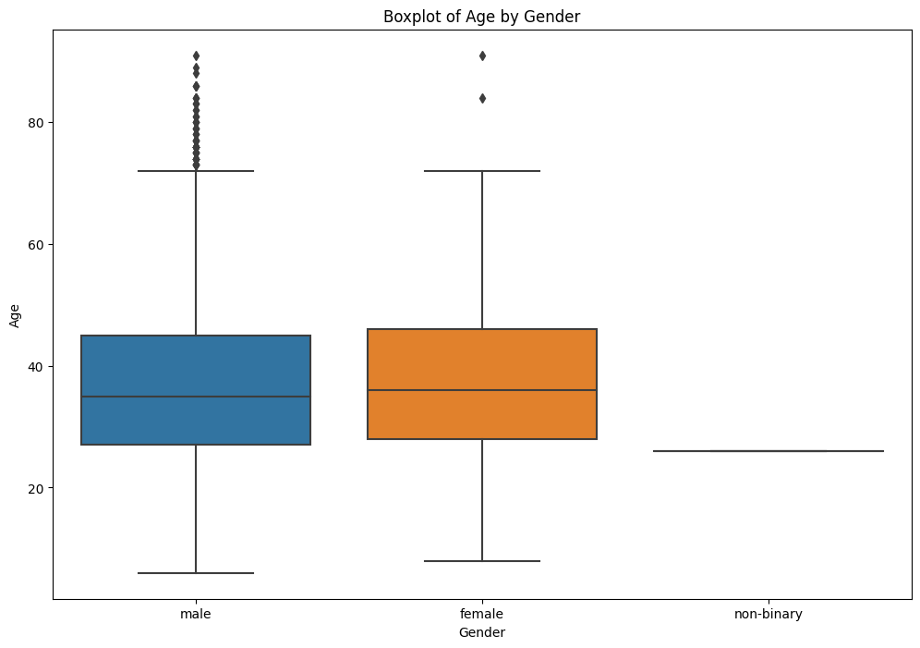
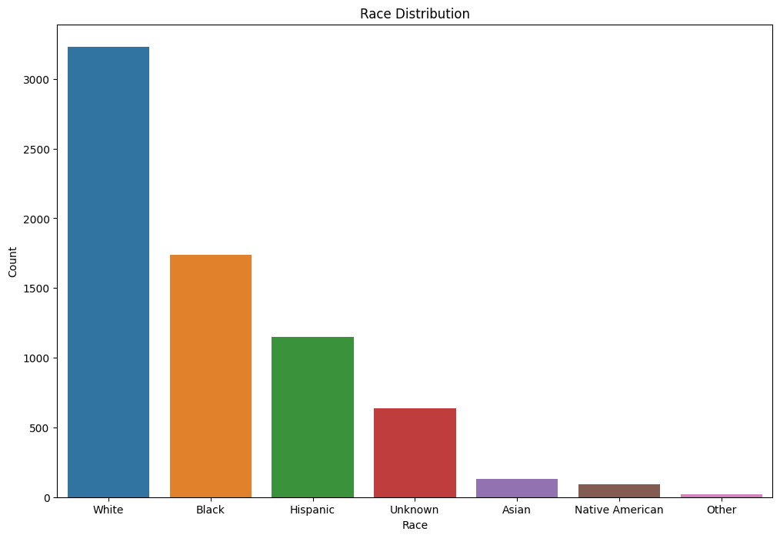
cont’d

Slide 9
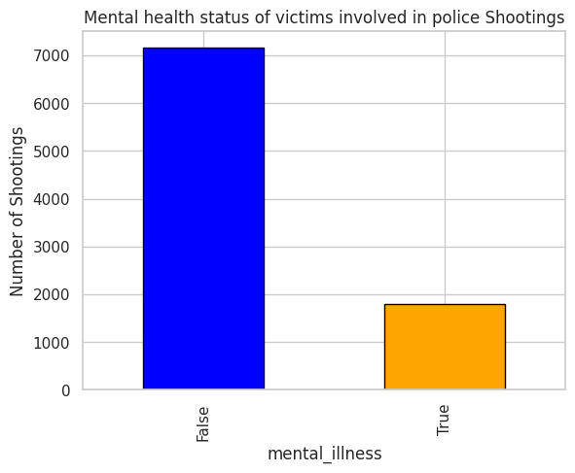
cont’d

Slide 10
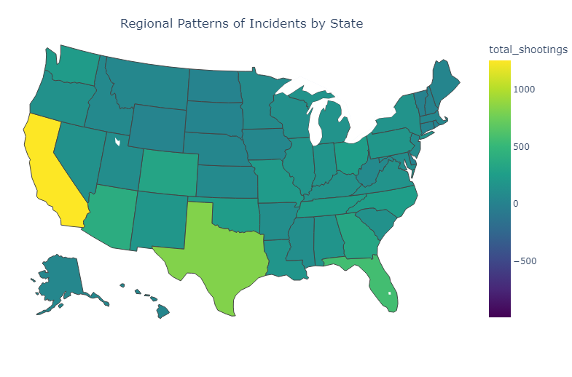
cont’d

Slide 11
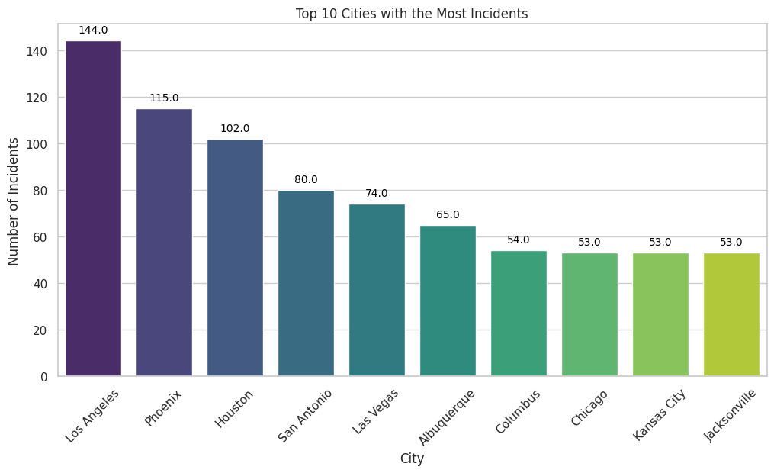
cont’d
- About 3,420 US cities have been involved in police shootings
- Los Angeles has the highest number of cases

Slide 12
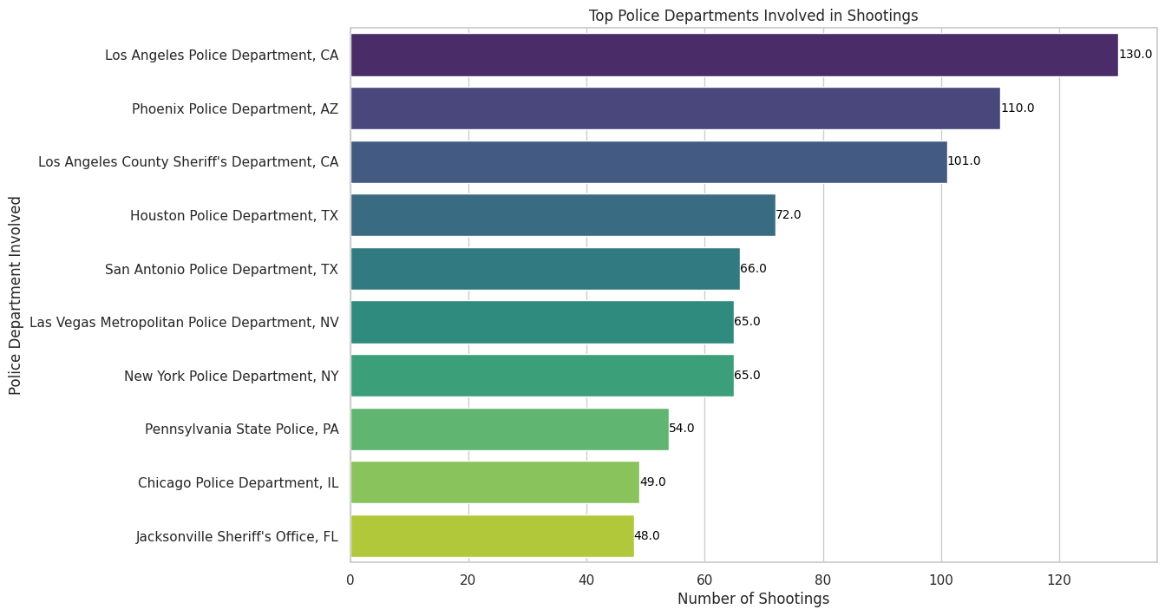
cont’d
- About 3,464 police departments have been involved in cases of police shootings from 2015 to 2023
- The Top 10 police departments involved are shown here

Slide 13
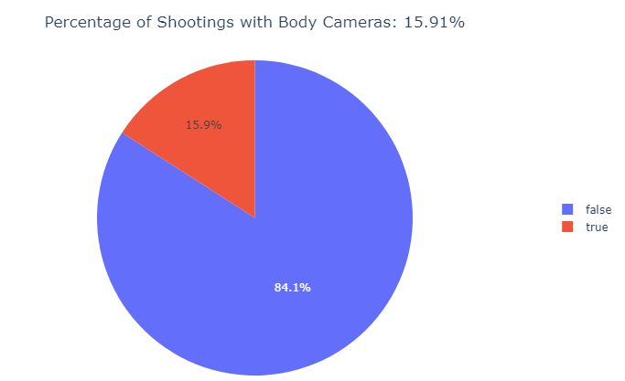
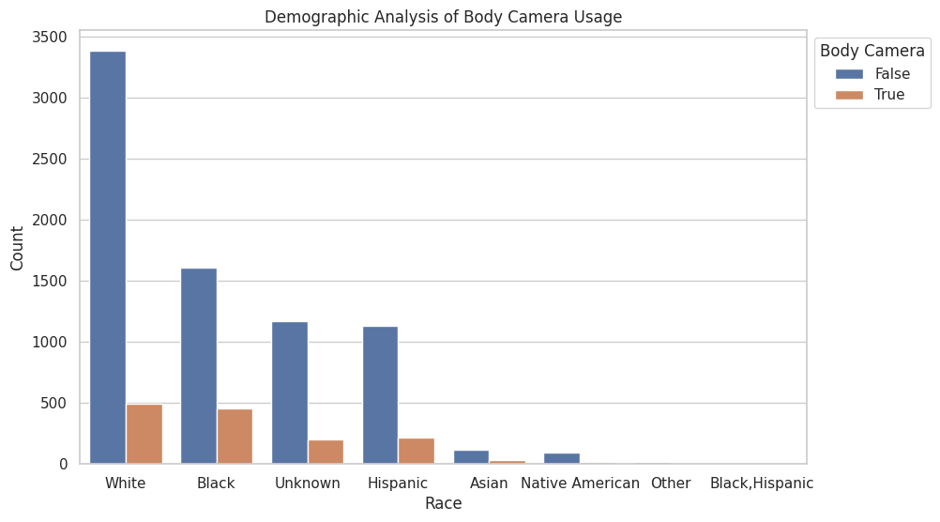
cont’d
- Police body cams are off in majority of the cases

Slide 14
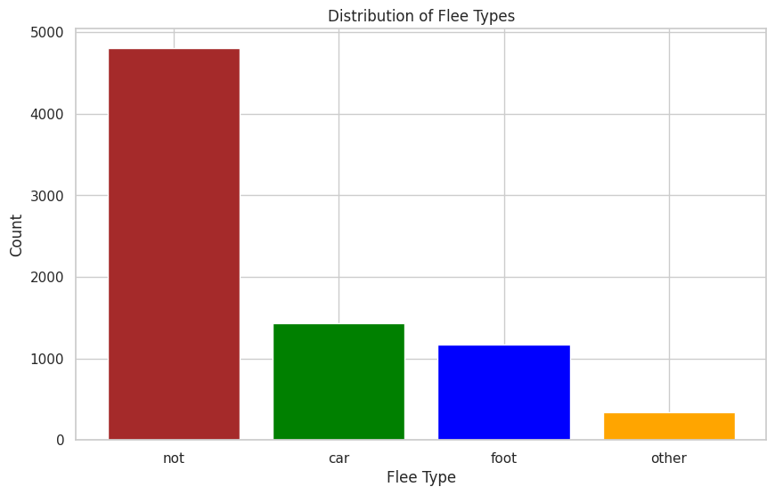
cont’d
- Majority of the victims do not flee during encounters with police

Slide 15
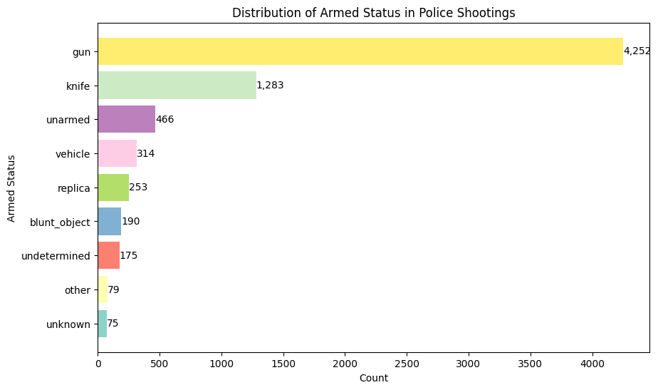
cont’d
More than half the victims were armed with guns

Slide 16

Conclusion
- Examining police shootings from 2015 to 2023 reveals a significant increase, particularly reaching its highest in 2022.
- In-depth analyses of demographic disparities, geographical influences, transparency concerns, armed status, and fleeing patterns have been conducted with the aim of understanding where the police department stands on the subject of public trust.

Slide 17

Recommendation
- This study proposes comprehensive recommendations, emphasizing the need for a collaborative, holistic approach to address and minimize alarming trends in unjustified and avoidable incidents.
- To achieve this, we advocate for the implementation and enforcement of policies that enhance transparency and accountability within law enforcement.

Slide 18

Questions?

